Slide 1


Dan Smart , Derek Shashek, Minette James and Suzanne Polk

Slide 2
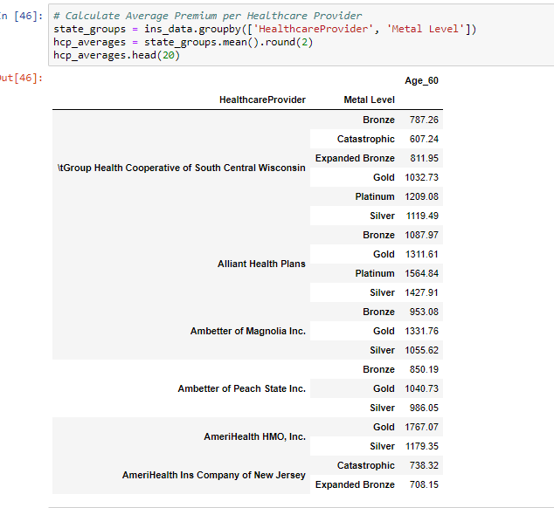
Data:
Data derived from Postgres ETL project.
Intention to group by healthcare provider, metal level, and aggregate their premiums through pandas.
Converted to .csv then dataset used for visualization.

Slide 3
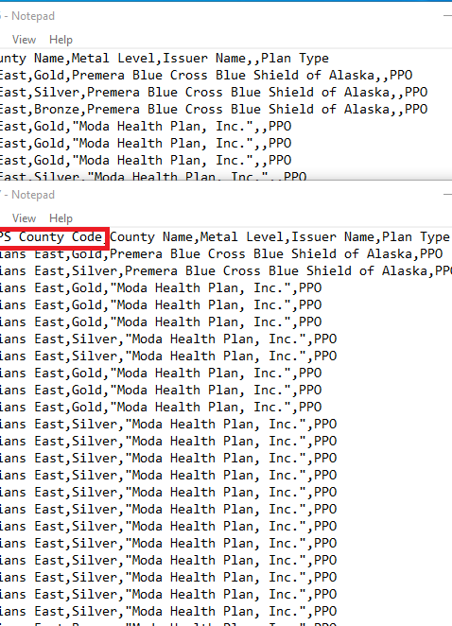
Inconsistent Data:
The data we used had inconsistent data across years. We committed to using this data set without realizing how poor it was for years before 2016.
Incorrect spellings and missing data made it difficult to manipulate the data for some years.

Slide 4
GeoJson:
Pandas will read geoJSON files but changes the format.
It is much easier to manipulate geoJson with libraries like geopandas, which creates geoDFs that can be manipulated.
The geojson library has features which allow the convenient creation of geojson feature groups.
View more documentation here: http://geopandas.org/

Slide 5
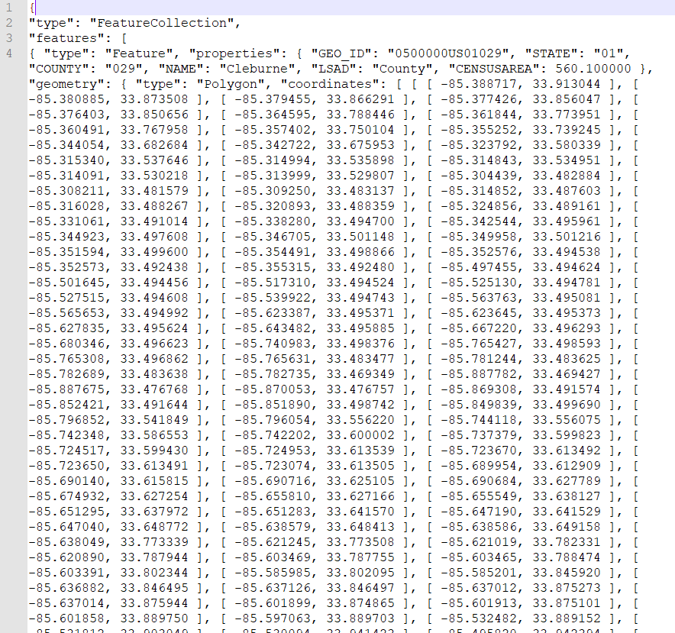
Erroneous Data:
States polygons pulled from the Census Bureau had spelling errors and needed to be reformatted to use.
Formatting errors of the original data
U.S. counties data presented a similar problem including errors in spelling of those counties in Puerto Rico.
Used D3, Leaflet and, Map box in the logic to visualize the data

Slide 6
Erroneous Data:
States polygons pulled from the Census Bureau had spelling errors and needed to be reformatted to use.
U.S. counties data presented a similar problem including errors in spelling of those counties in Puerto Rico.
Used D3, Leaflet and, Map box in the logic to visualize the data

Slide 7
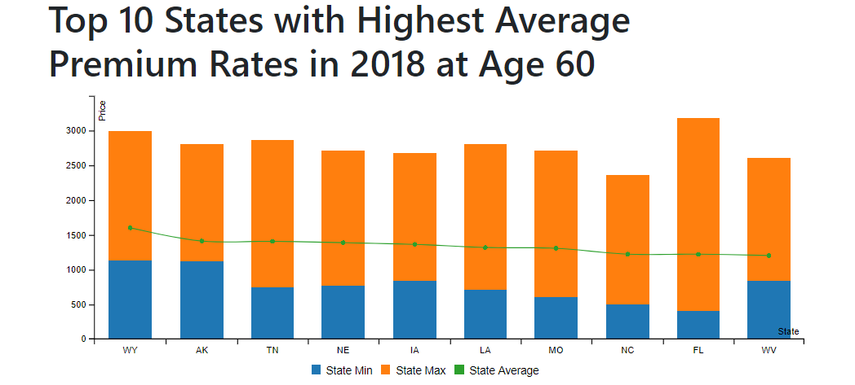
New Library: C3
more information here –
https://c3js.org/

Slide 8
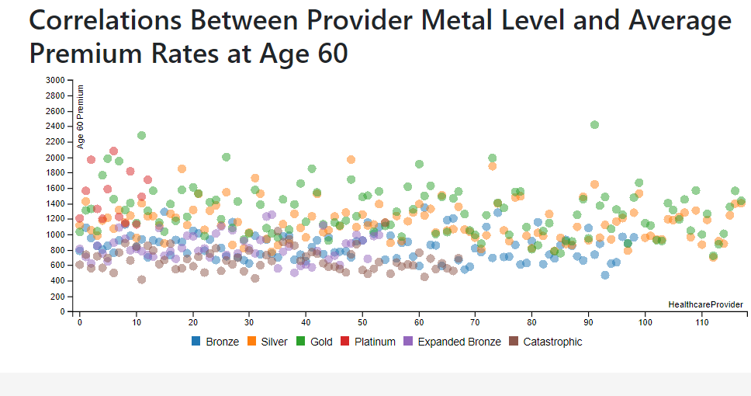
Metal Levels:
Bronze – Lowest Monthly Premium
Silver – Moderate Monthly Premium
Gold – High monthly Premium
Platinum – Highest monthly Premium
Expanded Bronze – a new Plan in 2018, an expansion of the Bronze plan
Catastrophic Plan – Affordability Exception
New Library: C3
more information here –
https://c3js.org/

Slide 9
Structure and integration
Bootstrap used to create the HTML structure for index and data pages.
ID tags in HTML used to integrate map and graphs.
Git Issues
Integrating the dependencies
Changing data types

Slide 10
In a Nutshell…
The team, observed that insurance plans increased plan types in 2018.
Insurance plans began to declines starting from 2015 to 2018.
Insurance premiums rates are relatively high at Age 60.
Alaska has the highest average premium rates at $1409.77

